Slide 1

Ai in surgery tag a2

Slide 2
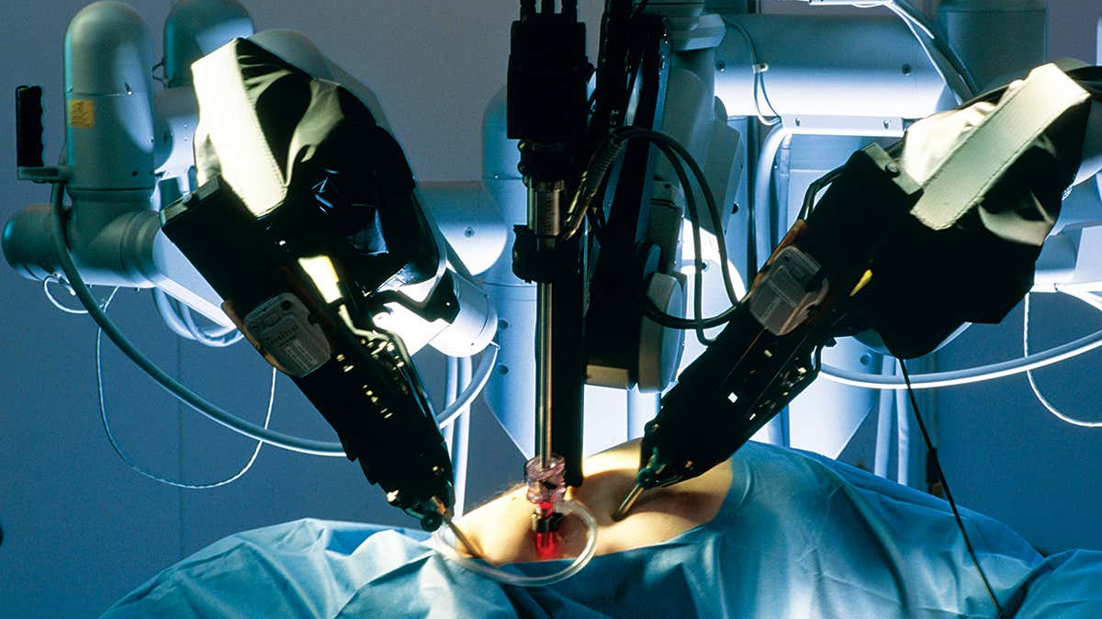
Application and scope
Computer Augmentation of human performance.
Improved identification of high risk patients.
Automated analysis of all preoperative mobile and clinical data could provide a more patient-specific risk score for operative planning and yield valuable predictors for postoperative care.

Slide 3
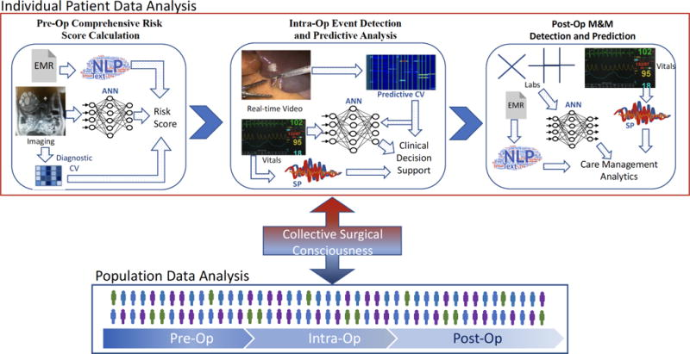
applications

Slide 4
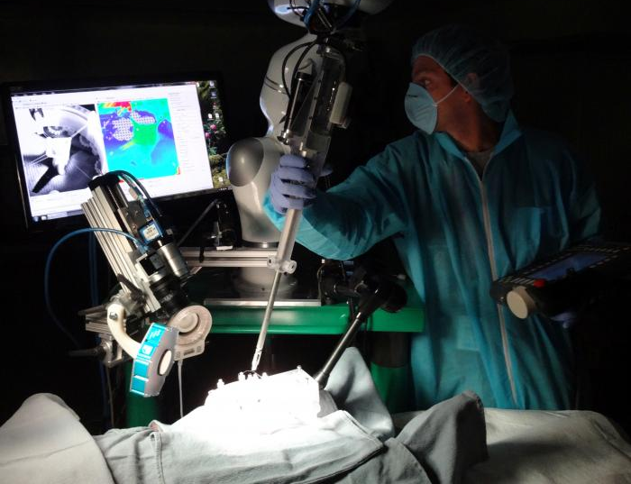
surgery on soft tissues
Surgeons tested STAR against manual surgery, laparoscopy, and robot-assisted surgery for porcine intestinal anastomosis, and found that the supervised autonomous surgery offered by the STAR system was superior.​

Slide 5

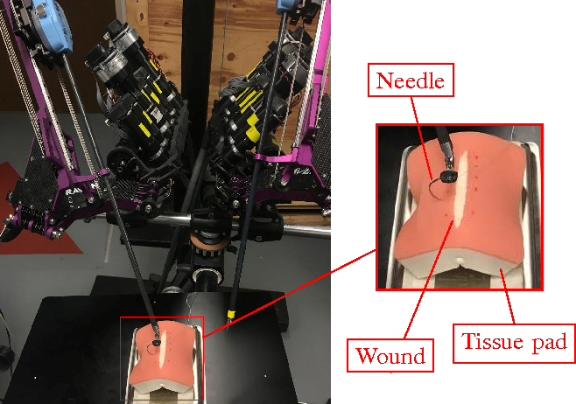
Supervised autonomous in vivo robotic surgery on soft tissues
1.Inspired by the best human surgical practices, a computer program generates a plan to complete complex surgical tasks on deformable soft tissue, such as suturing.
2.We compared metrics of anastomosis— the number of mistakes that required removing the needle from the tissue, completion time between our supervised autonomous system, manual laparoscopic surgery, and clinically used RAS approaches.
3.Despite tissue movement during surgery, we demonstrate that the outcome of supervised autonomous procedures is superior to surgery performed by expert surgeons and RAS techniques in living pigs.

Slide 6
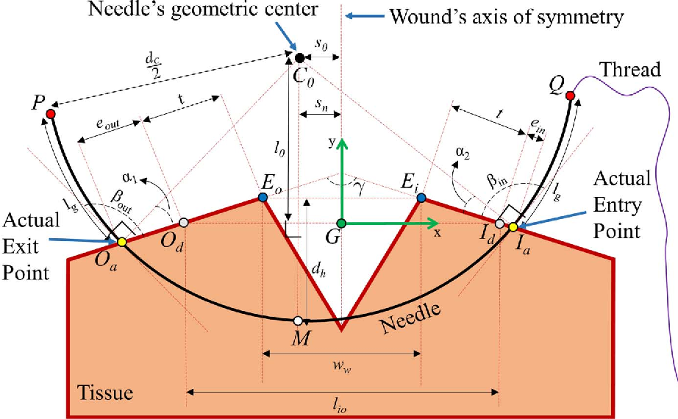
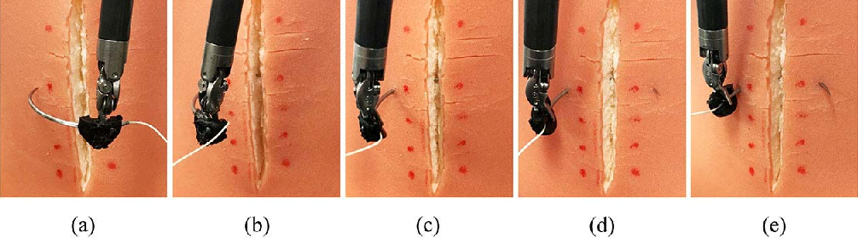
autonomous suturing algorithm
1.
In autonomous suturing with a surgical robot, needle shape, diameter, and path are critical parameters that directly affect suture depth and tissue trauma.
2.Input
The inputs of the optimization include the tissue geometry, surgeon defined entry/exit points, and optimization weighting factors.
3.Output
The outputs are the needle geometry and suggested path.
4.
The proposed needle path planning algorithm guarantees minimal tissue trauma and complies with a wide range of suturing requirements.

Slide 7

conclusion
These results demonstrate the potential for autonomous robots to improve the efficacy, consistency, functional outcome, and accessibility of surgical techniques.

Slide 8
Thank You

